Slide 1
MACHINE LEARNING PROJECT PRESENTATION
PRESENTED BY: EMAN TAHIR
REG# 2023-BS-AI-015
SUPERVISED BY: MR. M.SAEED

Slide 2
PROJECT INTRODUCTION
PROJECT 1:
STUDENT PERFROMANCE USING REGRESSION

Slide 3
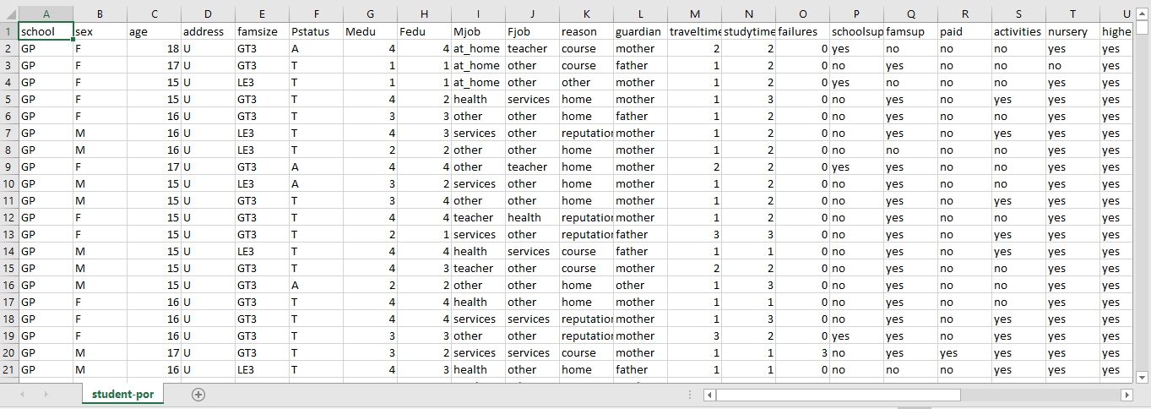
DATASET
SOURCE: Kaggle
DESCRIPTION:
The "Students Performance" dataset has 649 rows, it contains demographic, academic, and behavioural information of Portuguese secondary school students, aiming to analyse factors influencing their final grades and overall academic performance in Portuguese language.

Slide 4
PRE-PROCESSING STEPS
"Preprocessing steps refer to the essential data cleaning and transformation tasks performed before feeding data into a machine learning or statistical model. These steps improve data quality, ensure consistency, and make the dataset suitable for analysis or modelling."
Import Libraries: Load essential Python packages for data handling tasks.
Load Dataset: Read student performance data from a CSV file.
Explore Dataset: View data structure, types, and basic information.
Check Nulls: Identify missing values for cleaning or imputation.
Encode Categories: Convert categorical values into machine-readable numeric format.
Drop Irrelevant Features: Remove unnecessary or redundant columns from dataset.
Scale Features: Normalize feature values to a consistent numerical range.
Split Dataset: Divide data into training and testing subsets for modelling.
Visualize Data: Plot graphs to understand distributions and feature relationships.
Prepare for Modelling: Finalize clean, structured input for regression model.

Slide 5
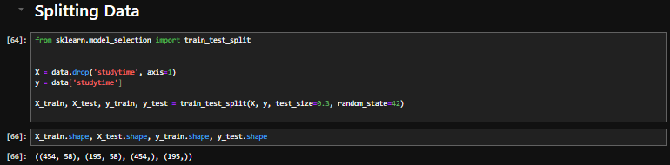
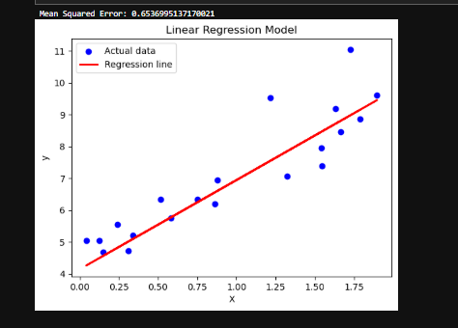
MODELING
Train-Test Split Splitting data into training and testing sets.
Model Training Using .fit(X_train, y_train) to train the regression model.
Linear Regression Model Applying LinearRegression() from sklearn.linear_model.
Prediction Making predictions on test data using .predict(X_test).

Slide 6
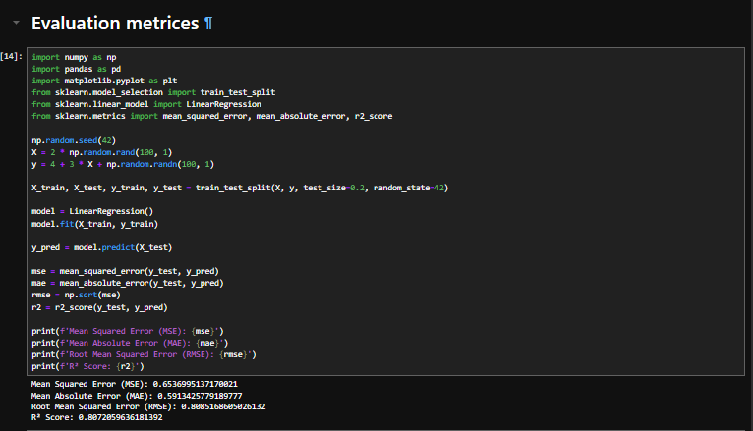
EVALUATION
Mean Absolute Error (MAE) Measures average absolute difference between predicted and actual values.
Mean Squared Error (MSE) Measures average squared difference between predicted and actual values.
Root Mean Squared Error (RMSE) Square root of MSE. interpretable in original units.
R² Score (Coefficient of Determination) Indicates how well the model explains the variance in the data.

Slide 7
KEY FINDINGS
Regression model effectively predicted student grades using input features.
Data was correctly split into training and testing sets.
The project used meaningful evaluation metrics (MAE, RMSE, R²).
Feature encoding allowed smooth model training.
The approach provided useful insight into performance-driving factors.

Slide 8
CONCLUSION
The regression model moderately predicted student academic performance based on personal and educational features. While basic preprocessing and evaluation were effective, incorporating outlier handling and more advanced techniques could improve prediction accuracy. The project highlights the value of data-driven approaches in education analytics.

Slide 9
THANKYOU!

